Slide 1
Operating Systems
Chapter 3 Process Description and Control

Slide 2
Agenda
3.1 What is a Process
3.2 Process States
3.3 Process Description
3.4 Process Control

Slide 3
3.1 What is a Process
3.1.1 Background
3.1.2 Processes and Process Control Blocks

Slide 4
Requirements of an Operating System(操作系统需求)
Interleave(交替) the execution of multiple jobs/tasks/道/programs/processes to
  maximize processor utilization
  while providing reasonable response time(响应时间)
Allocate resources to processes(资源分配)
Support interprocess communication(进程间通信) and user creation of processes

Slide 5
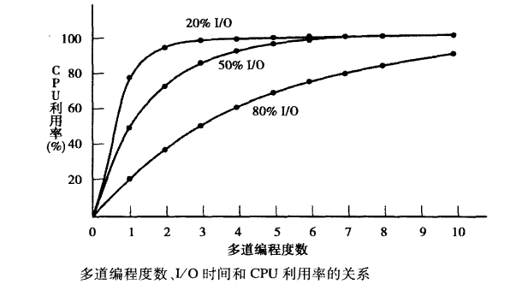
Notes:
1-p^n,p为进程未使用CPU的时间占总时间的比例

Slide 6
顺序程序
程序：
  指令或语句序列，体现了某种算法，所有程序是顺序的
数据输入
进行计算
结果输出

Slide 7
程序的特征：
顺序性
封闭性
可再现性

Slide 8
程序的并发执行
I1
I2
I3
I4
C1
C2
C3
C4
P1
P2
P3
P4
t
Notes:
I,C,P是三个相互合作的程序，I代表输入，C代表计算，P代表打印输出

Slide 9
特征：
（1）失去了程序的封闭性
（2）程序和机器执行程序的活动不再一一对应。
（3）并发程序之间互相制约
    合作
    竞争
（4）并发程序的执行呈现“走——停——走”的活动规律。(两状模型)

Slide 10
3.1 What is a Process
3.1.1 Background
3.1.2 Processes and Process Control Blocks

Slide 11
Process
A program in execution
An instance of a program running on a computer
The entity that can be assigned to and executed on a processor
A unit of activity characterized by：
  the execution of a sequence of instructions
  a current state
  an associated set of system resources
……

Slide 12
进程的概念
定义：Process
进程是一个具有独立功能的程序关于某个数据集合的一次运行活动，是系统进行资源分配和调度的独立单位。
进展中的程序：
进程=程序+执行

Slide 13
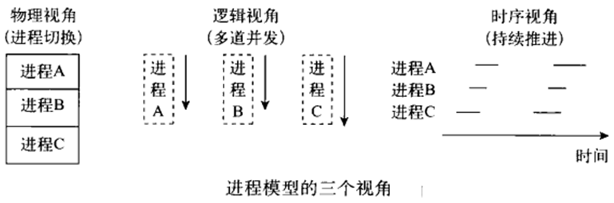
进程模型
Notes:
从三个视角看到待进程

Slide 14
Review: 2.3.1 The Processes
进程构成：Consists of three components
  An executable program /code
  Associated data needed by the program
  Execution context of the program (the core)
    All information the operating system needs to manage the process
      Hardware
      Software

Slide 15
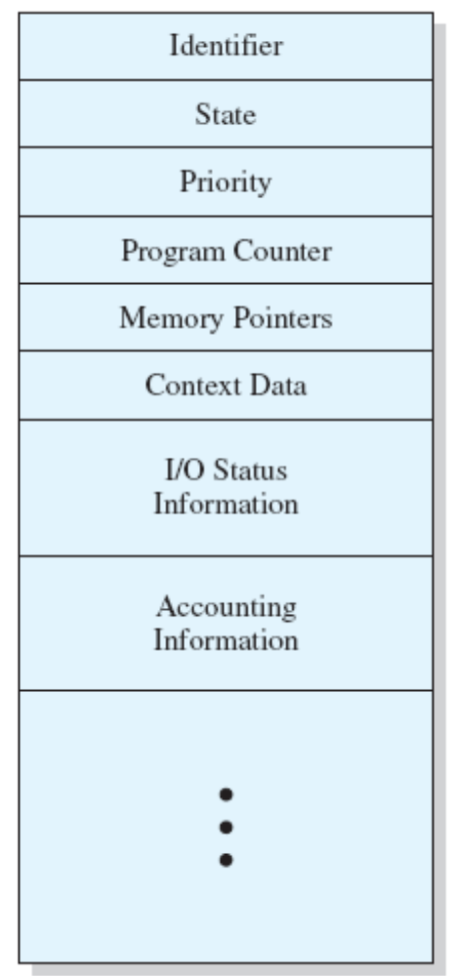
Process Control Block
Identifier
State
Priority
Program counter
Memory pointers
Context data
I/O status information
Accounting information
进程控制块

Slide 16
Agenda
3.1 What is a Process
3.2 Process States
3.3 Process Description
3.4 Process Control

Slide 17
3.2 Process States
3.2.1 Trace of the Process
3.2.2 A Two-State Process Model
3.2.3 The Creation and Termination of Processes
3.2.4 A Five-State Model
3.2.5 Suspended Process

Slide 18
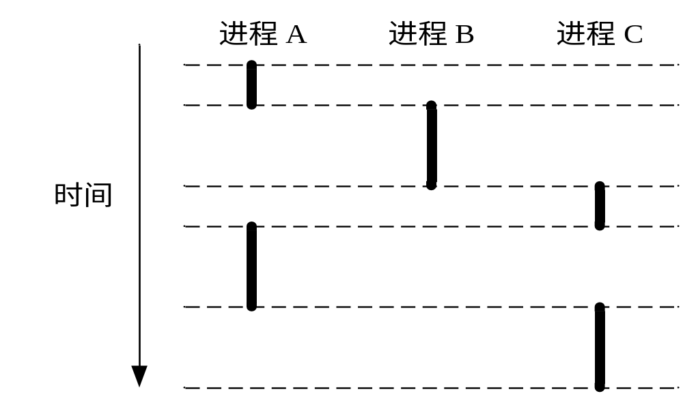
Trace of Process(进程轨迹)
Sequence of instruction that execute for a process
Dispatcher(调度器/scheduler) switches the processor from one process to another

Slide 19
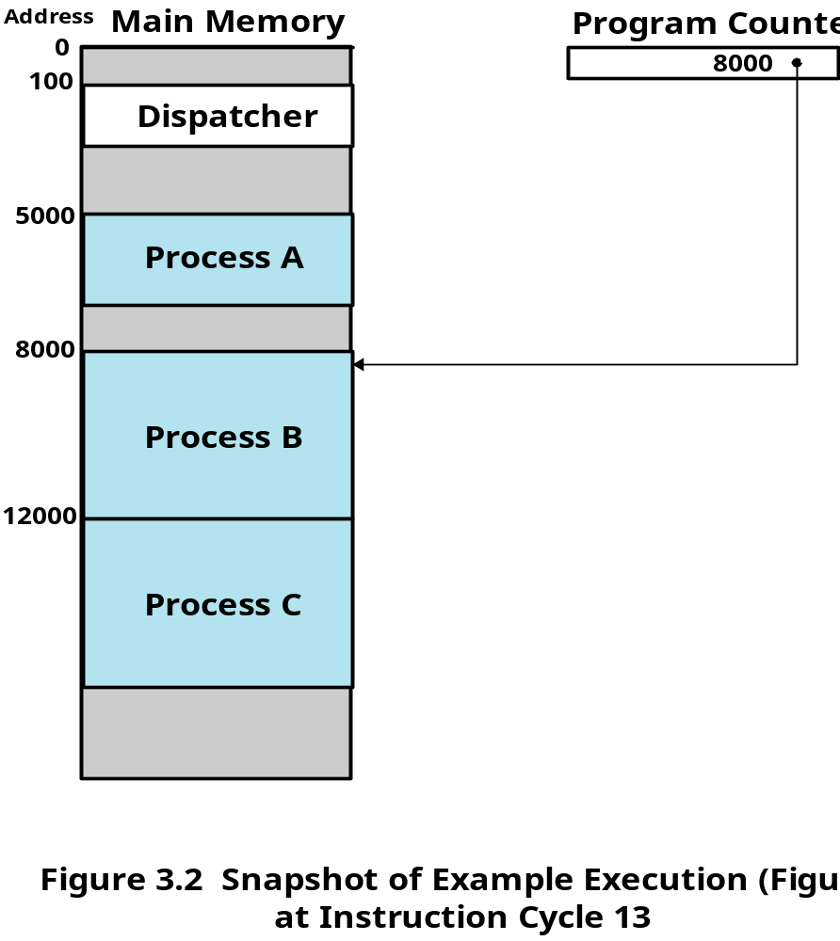
Example Execution

Slide 20
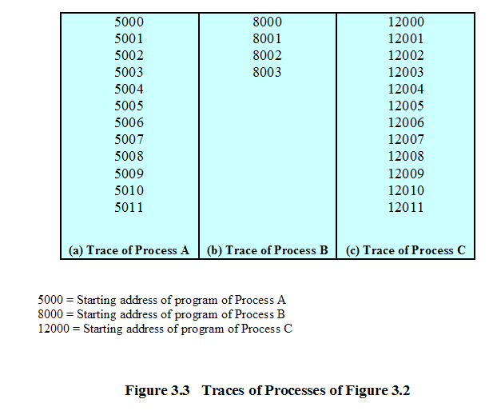
Trace of Processes

Slide 21
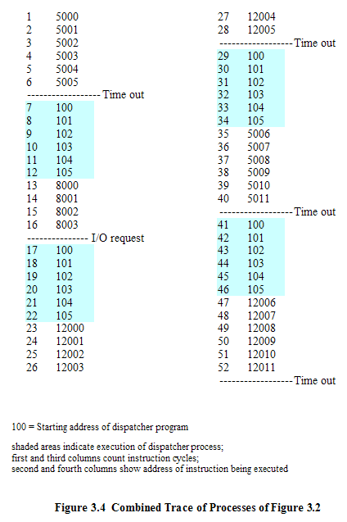
Trace of Processes

Slide 22
3.2 Process States
3.2.1 Trace of the Process
3.2.2 A Two-State Process Model
3.2.3 The Creation and Termination of Processes
3.2.4 A Five-State Model
3.2.5 Suspended Process

Slide 23
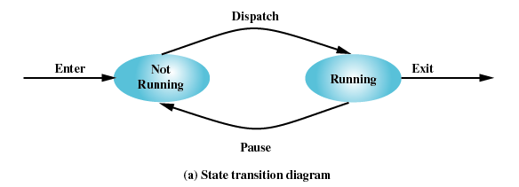
Two-State Process Model
Process may be in one of two states
  Running
  Not-running

Slide 24
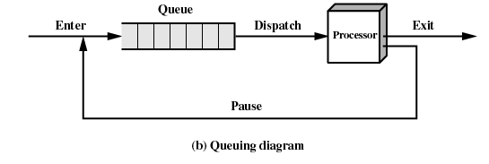
Not-Running Process in a Queue

Slide 25
3.2 Process States
3.2.1 Trace of the Process
3.2.2 A Two-State Process Model
3.2.3 The Creation and Termination of Processes
3.2.4 A Five-State Model
3.2.5 Suspended Process

Slide 26
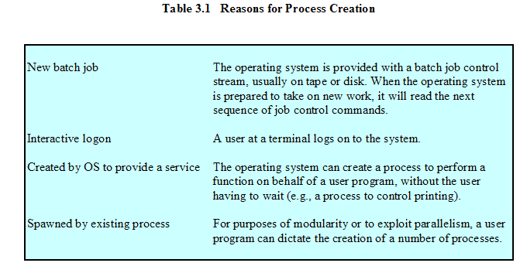
Process Creation
派生

Slide 27
Process Creation
Assign a unique process identifier
Initialize process control block
Allocate space for the process
Set up appropriate linkages
  Ex: add new process to linked list used for scheduling queue
Create of expand other data structures
  Ex: maintain an accounting file

Slide 28
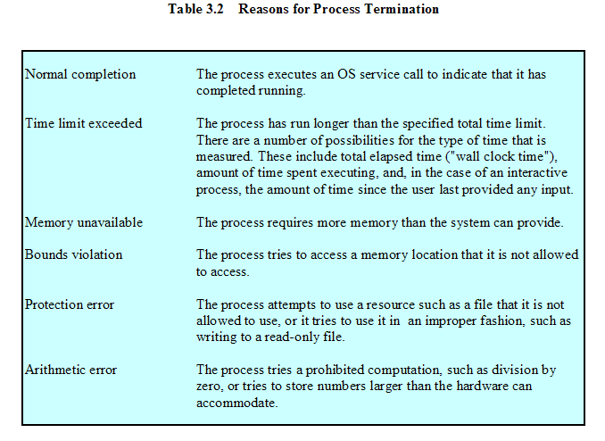
Process Termination

Slide 29
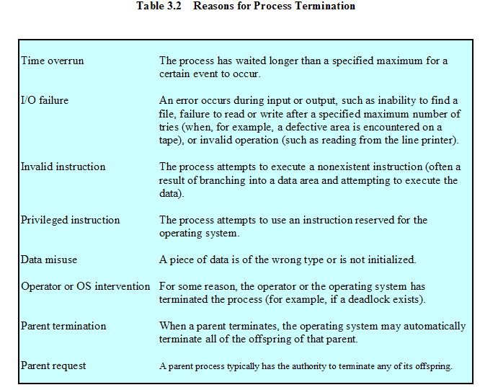
Process Termination

Slide 30
3.2 Process States
3.2.1 Trace of the Process
3.2.2 A Two-State Process Model
3.2.3 The Creation and Termination of Processes
3.2.4 A Five-State Model
3.2.5 Suspended Process

Slide 31
Limit of Two-State Process Model
Not-running
  ready to execute
  waiting for I/O (blocked)
单个队列所存在的问题：:Dispatcher cannot just select the process that has been in the queue the longest, because it may be blocked
  多队列
    就绪队列
    阻塞队列

Slide 32
A Five-State Model
Running(运行态)
Ready(就绪态)
Blocked(阻塞态)
New(新建态)
Exit(退出态)

Slide 33
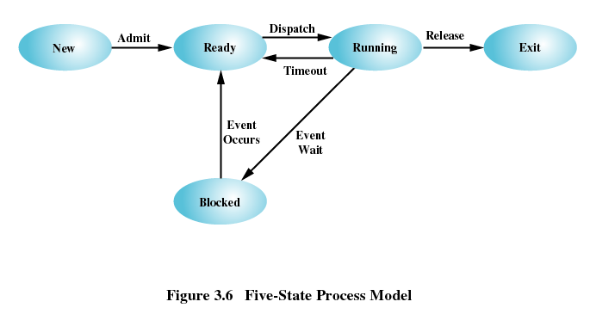
Five-State Process Model

Slide 34
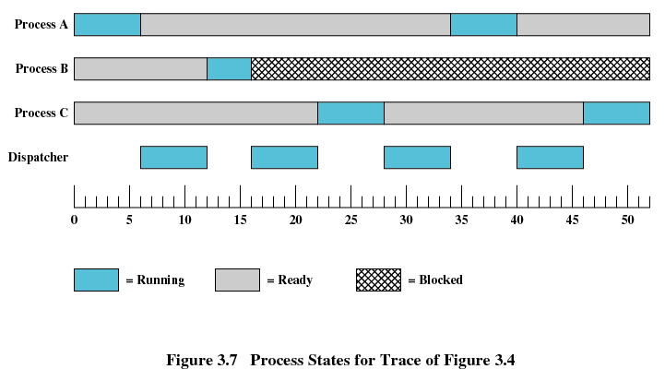
Process States

Slide 35
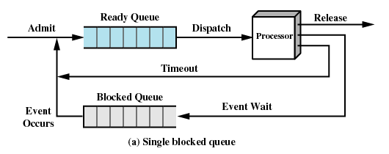
Using Two Queues

Slide 36
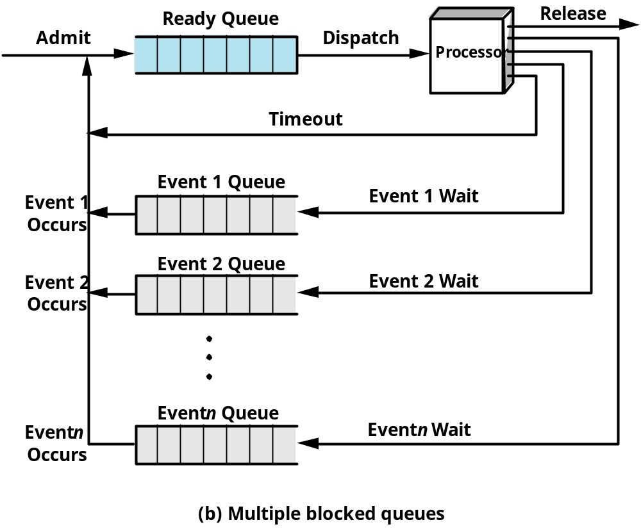
Multiple Blocked Queues

Slide 37
3.2 Process States
3.2.1 Trace of the Process
3.2.2 A Two-State Process Model
3.2.3 The Creation and Termination of Processes
3.2.4 A Five-State Model
3.2.5 Suspended Process

Slide 38
Suspended Processes(被挂起的进程)
Processor is faster than I/O so all processes could be waiting for I/O
Swap these processes to disk to free up more memory
  Blocked state becomes suspend state when swapped to disk
Two new states
  Blocked/Suspend
  Ready/Suspend

Slide 39
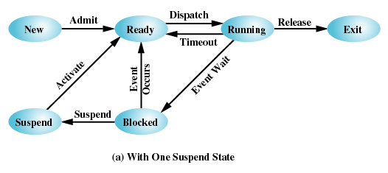
One Suspend State

Slide 40
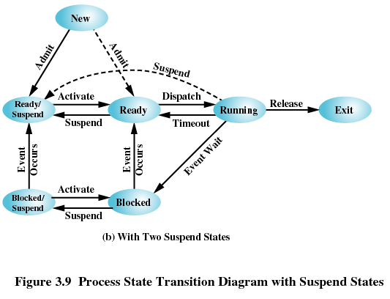
Two Suspend States

Slide 41
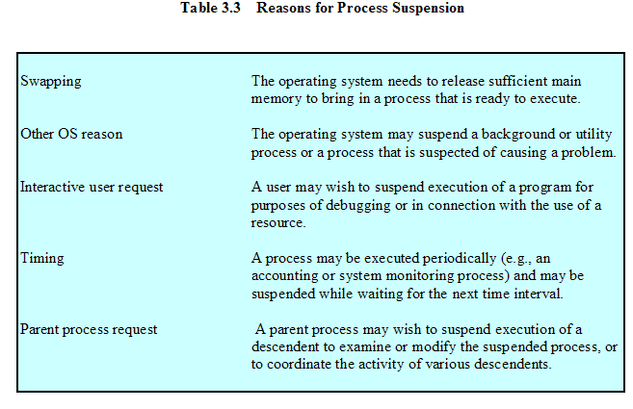
Reasons for Process Suspension
Notes:
Swapping:操作系统需要腾出更多的内存空间以加载更多的就绪进程；
Other: OS对可疑进程执行挂起，检测;
Interactive: 用户需要对某个进程进行检查，如有于程序调试;
Timing:周期执行的程序在下一次执行周期到来前挂起等待执行；

Slide 42
Agenda
3.1 What is a Process
3.2 Process States
3.3 Process Description
3.4 Process Control

Slide 43
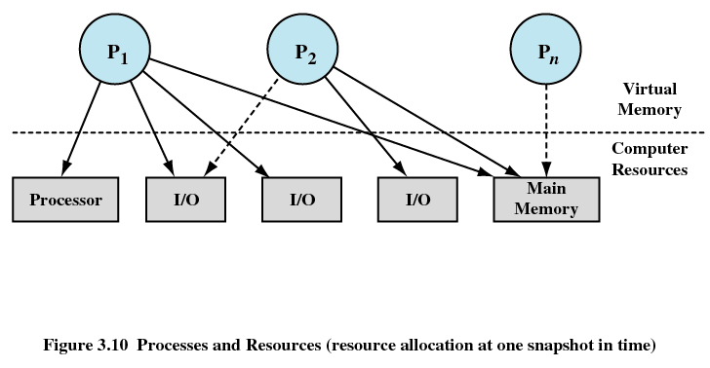
Processes and Resources

Slide 44
Operating System Control Structures
为了管理进程和资源，操作系统必须掌握每一个进程和资源的当前状态信息。几乎所有操作系统都会用以下4类表来保存信息：内存表、I/O表、文件表和进程表 。
①内存表用来跟踪主(实)存和辅(虚拟)存。
②I/O表用来管理I/O设备和通道。
③文件表提供当前存在文件中的信息：文件在辅存中的位置、当前状态及其他性质。
④进程表用来管理进程。

Slide 45
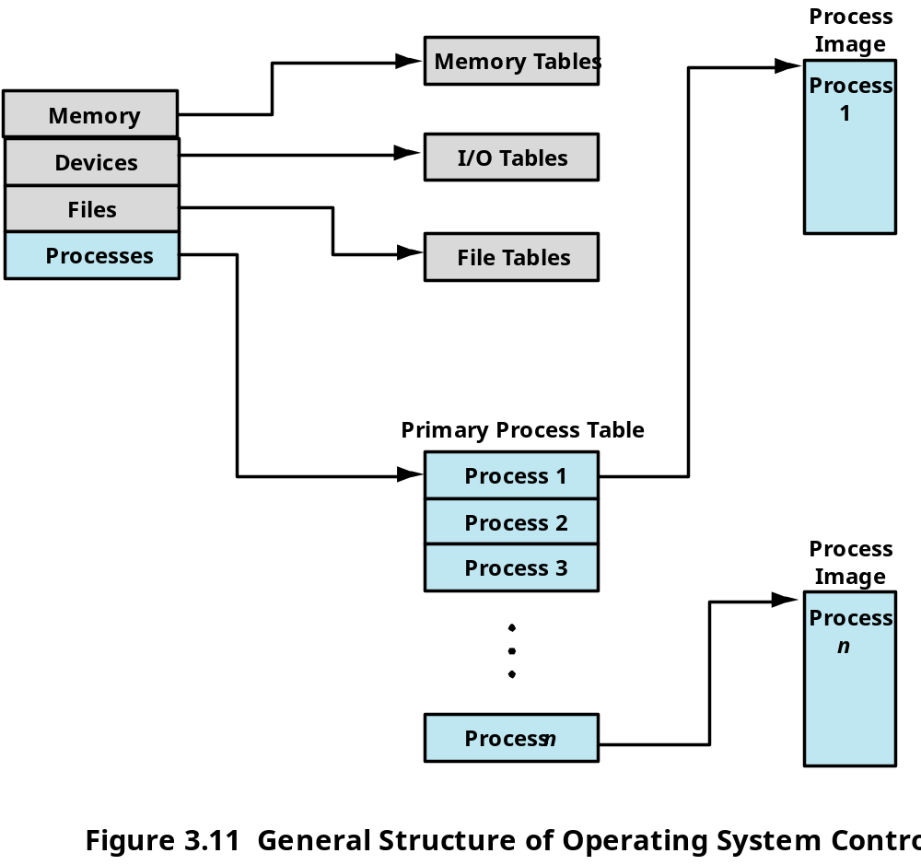
Structure of OS Control Tables

Slide 46
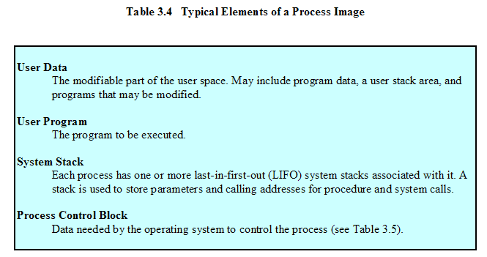
Process Image

Slide 47
Process Control Block
Process Identification: (1/3)
Processor State Information : (2/3)
  User-Visible Registers (用户程序可访问，8-32个)
  Control and Status Registers(PC,PSW)
  Stack Pointers(SP)
Process Control information : (3/3)
  Address of code and data 程序段和数据段首地址
  Interprocess Communication 信号量、消息
  Process Privileges 进程优先级
  Process State 进程状态：ready, block, suspend...
  Resource Ownership and Utilization 资源清单

Slide 48
Agenda
3.1 What is a Process
3.2 Process States
3.3 Process Description
3.4 Process Control

Slide 49
3.4 Process Control
3.4.1 Modes of Execution
3.4.2 Process Creation
3.4.3 Process Switching
3.4.4 Execution of the Operating System

Slide 50
Process Control进程控制
为了防止操作系统及关键数据如PCB等，受到用户程序有意或者无意的破坏，通常将处理机的执行状态分为：
    *管态（系统态）
    *目态（用户态）

Slide 51
Process Control进程控制
两种执行模式
系统模式（系统态）、控制模式或者内核模式：
  具有较高特权
  运行系统特定的指令，包括读/写控制寄存器的指令、基本I/O指令以及与存储器管理有关的指令，及一些特定的内存区
  内核模式下的处理机及其指令、寄存器和内存都受到完全控制和保护。
用户模式（用户态）
  具有较低的特权
  用户程序一般运行在用户模式

Slide 52
Process Control进程控制
模式切换
用户模式——》系统模式：用户程序执行到一条系统调用，进入操作系统内核执行。
系统模式——》用户模式：执行完系统调用的功能，返回到用户程序。
特殊情况：程序执行到结束语句时，切换到系统模式，不再返回用户程序。

Slide 53
3.4 Process Control
3.4.1 Modes of Execution
3.4.2 Process Creation
3.4.3 Process Switching
3.4.4 Execution of the Operating System

Slide 54
Process Creation
Assign a unique process identifier
Allocate space for the process
Initialize process control block
Set up appropriate linkages
  Ex: add new process to linked list used for scheduling queue
Create of expand other data structures
  Ex: maintain an accounting file

Slide 55
3.4 Process Control
3.4.1 Modes of Execution
3.4.2 Process Creation
3.4.3 Process Switching
3.4.4 Execution of the Operating System

Slide 56
When to Switch a Process
interrupt
  1) Clock interrupt
    process has executed for the maximum allowable time slice
  2) I/O interrupt
  3) Memory fault
    memory address is in virtual memory so it must be brought into main memory
Notes:
2)讲了IO事件发生后， 原来阻塞的进程变为就绪了，若其优先级更高，则可以被调度执行
3)讲了进程从运行到阻塞的两种情况，

Slide 57
When to Switch a Process
Trap
  error or exception occurred
  may cause process to be moved to Exit state
Supervisor call (System Call)
  such as file open

Slide 58
进程切换
在某时刻，一个正在运行的进程被中断，操作系统就将另一个进程置为运行状态，并对其进行控制。
当操作系统掌握控制权时，切换随时会发生。可能将控制权交给操作系统的事件有：中断 、陷阱以及系统调用 。

Slide 59
进程上下文切换
上下文切换发生时，可能并不改变当前处于运行态的进程状态(如发生系统调用时)。当前运行进程的状态要改变时，操作系统将进行以下步骤完成进程切换：
① 保存处理器内容。
② 对当前运行进程的PCB进行更新。
③ 将这个进程的PCB移入适当的队列(就绪、阻塞)。
④ 挑选其他进程执行。
⑤ 对挑选进程的PCB进行更新。
⑥ 对寄存器/存储器管理数据结构进行更新。
⑦ 将被选中进程上次移出时的处理器状态进行恢复。

